Slide 1
The Medium Access Control Sublayer
Chapter 4

Slide 2
The Channel Allocation Problem
Static Channel Allocation in LANs and MANs
Dynamic Channel Allocation in LANs and MANs

Slide 3
Dynamic Channel Allocation in LANs and MANs
Station Model.
Single Channel Assumption.
Collision Assumption.
(a) Continuous Time. (b) Slotted Time.
(a) Carrier Sense. (b) No Carrier Sense.

Slide 4
Multiple Access Protocols
ALOHA
Carrier Sense Multiple Access Protocols
Collision-Free Protocols
Limited-Contention Protocols
Wavelength Division Multiple Access Protocols
Wireless LAN Protocols

Slide 5
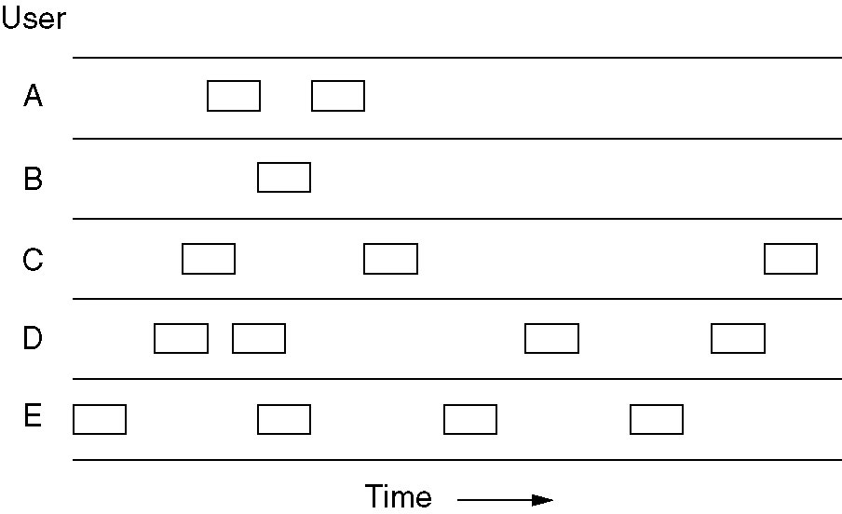
Pure ALOHA
In pure ALOHA, frames are transmitted at completely arbitrary times.

Slide 6
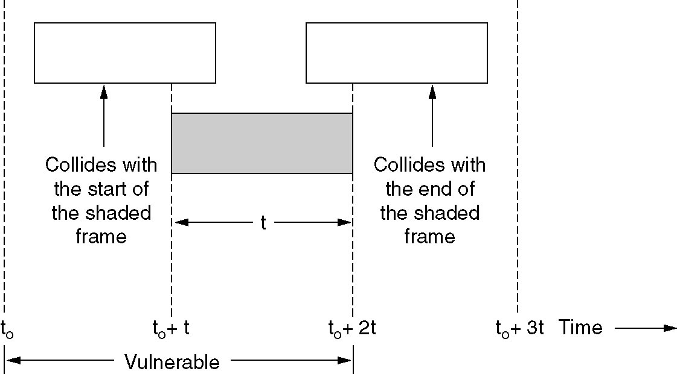
Pure ALOHA (2)
Vulnerable period for the shaded frame.

Slide 7
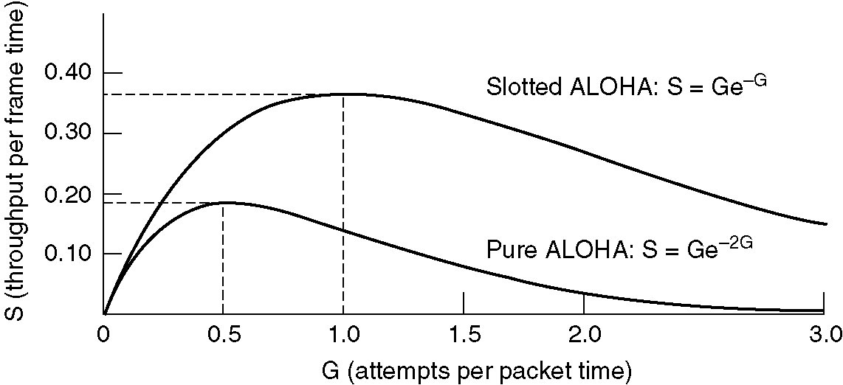
Pure ALOHA (3)
Throughput versus offered traffic for ALOHA systems.

Slide 8
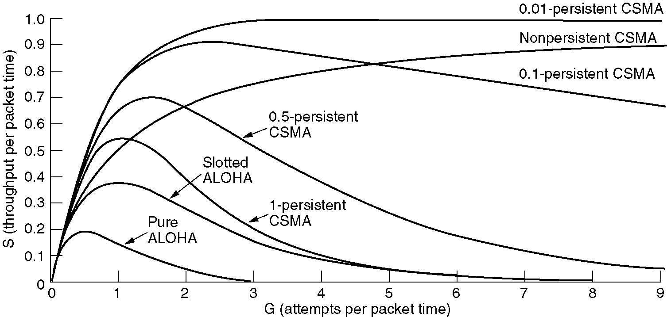
Persistent and Nonpersistent CSMA
Comparison of the channel utilization versus load for various random access protocols.

Slide 9
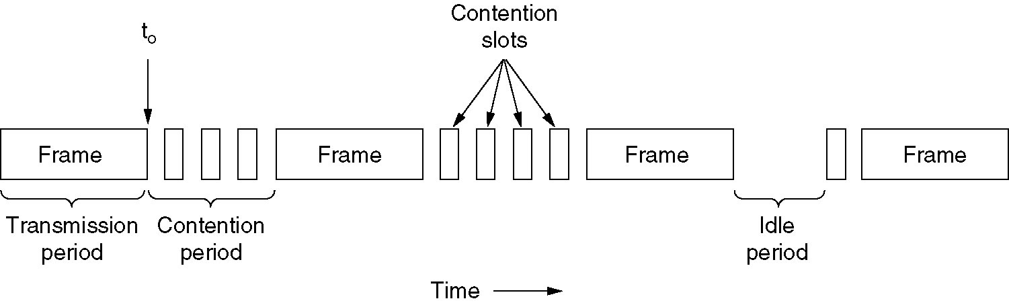
CSMA with Collision Detection
CSMA/CD can be in one of three states: contention, transmission, or idle.

Slide 10
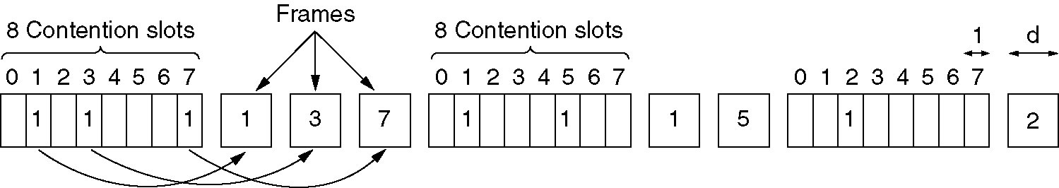
Collision-Free Protocols
The basic bit-map protocol.

Slide 11
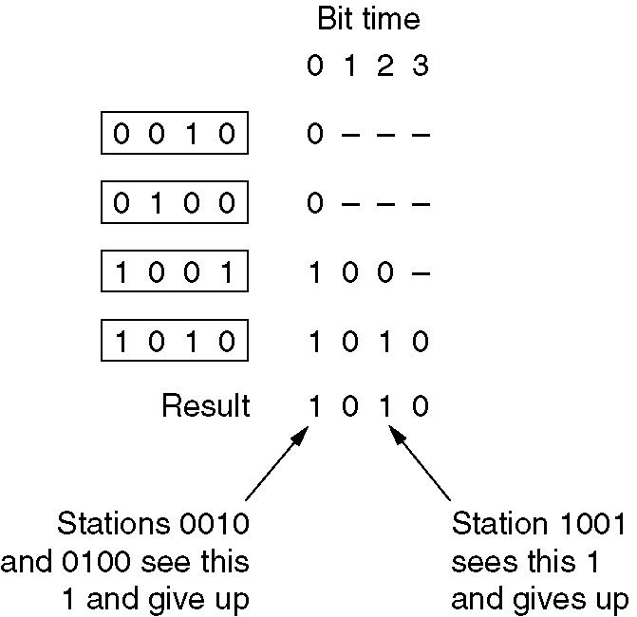
Collision-Free Protocols (2)
The binary countdown protocol. A dash indicates silence.

Slide 12
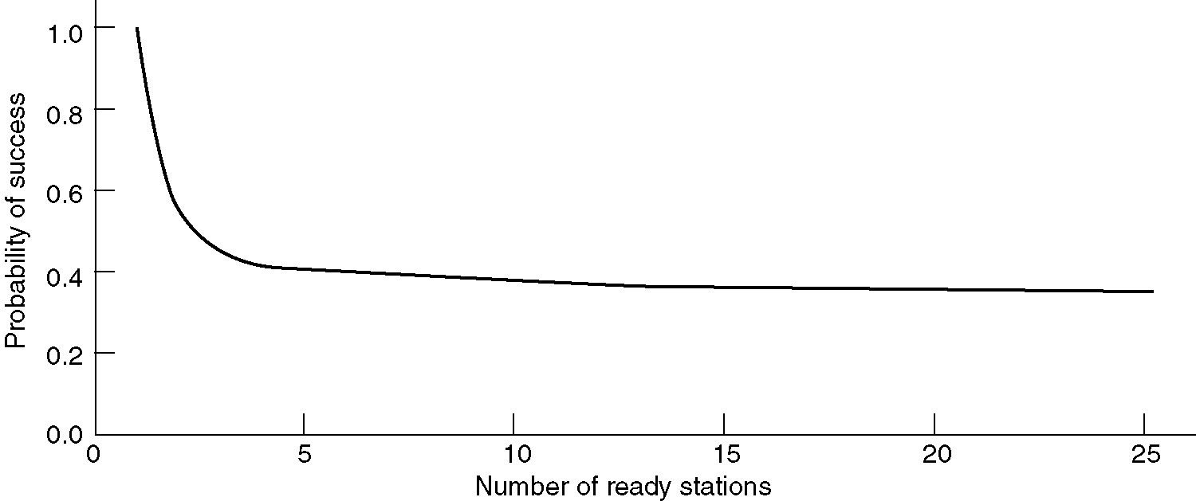
Limited-Contention Protocols
Acquisition probability for a symmetric contention channel.

Slide 13
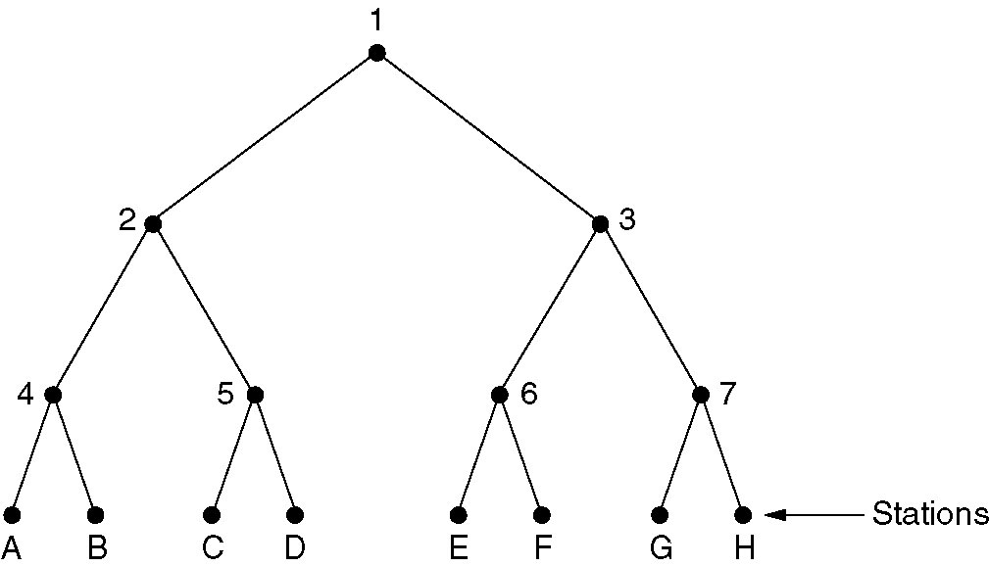
Adaptive Tree Walk Protocol
The tree for eight stations.

Slide 14
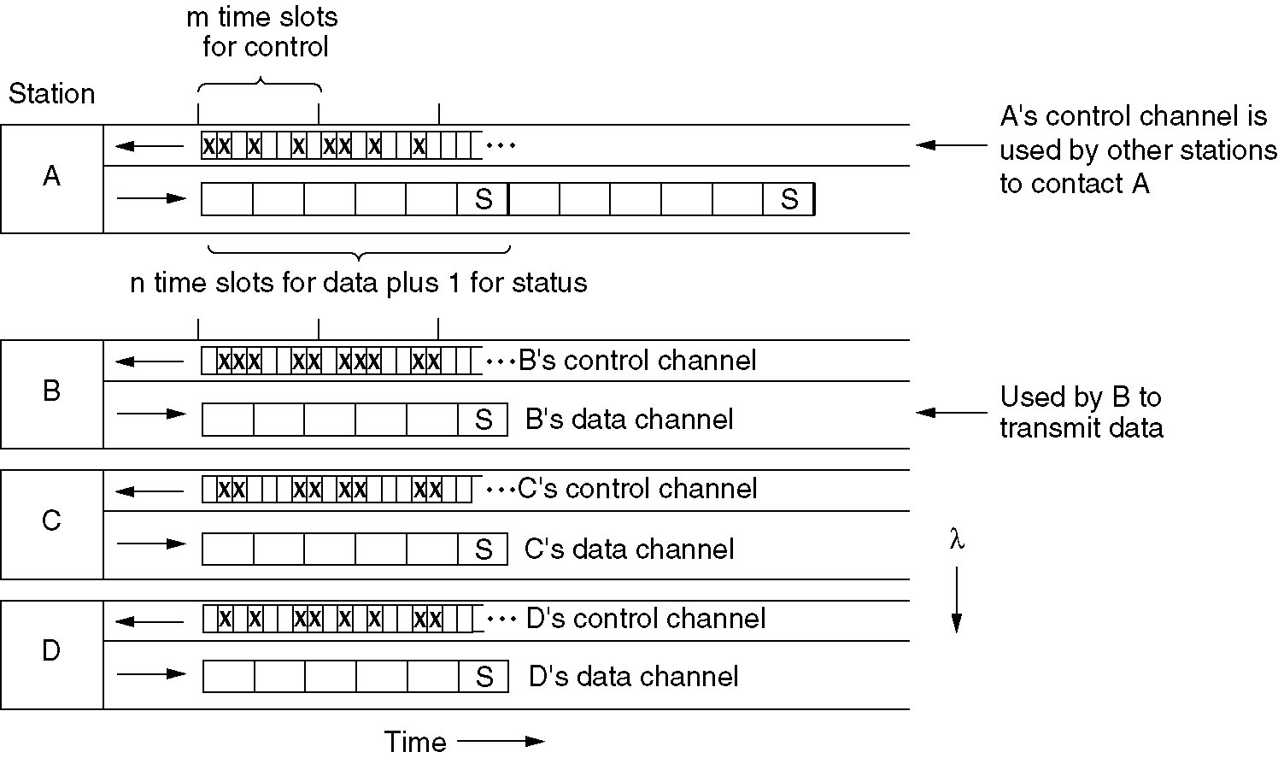
Wavelength Division Multiple Access Protocols
Wavelength division multiple access.

Slide 15
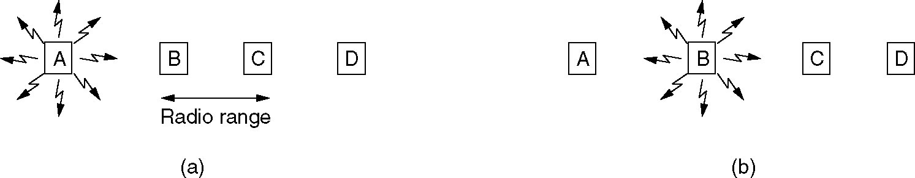
Wireless LAN Protocols
A wireless LAN. (a) A transmitting. (b) B transmitting.

Slide 16
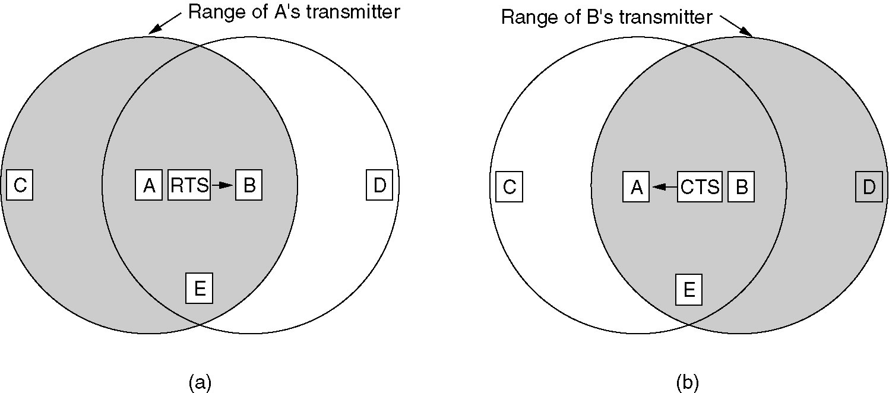
Wireless LAN Protocols (2)
The MACA protocol. (a) A sending an RTS to B.
(b) B responding with a CTS to A.

Slide 17
Ethernet
Ethernet Cabling
Manchester Encoding
The Ethernet MAC Sublayer Protocol
The Binary Exponential Backoff Algorithm
Ethernet Performance
Switched Ethernet
Fast Ethernet
Gigabit Ethernet
IEEE 802.2: Logical Link Control
Retrospective on Ethernet

Slide 18
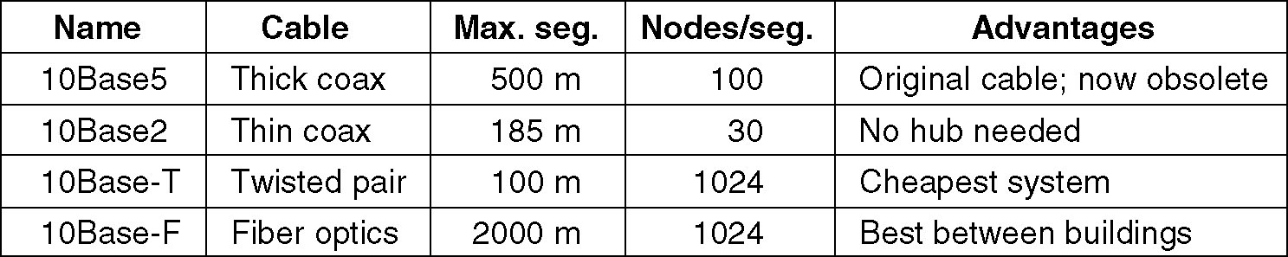
Ethernet Cabling
The most common kinds of Ethernet cabling.

Slide 19
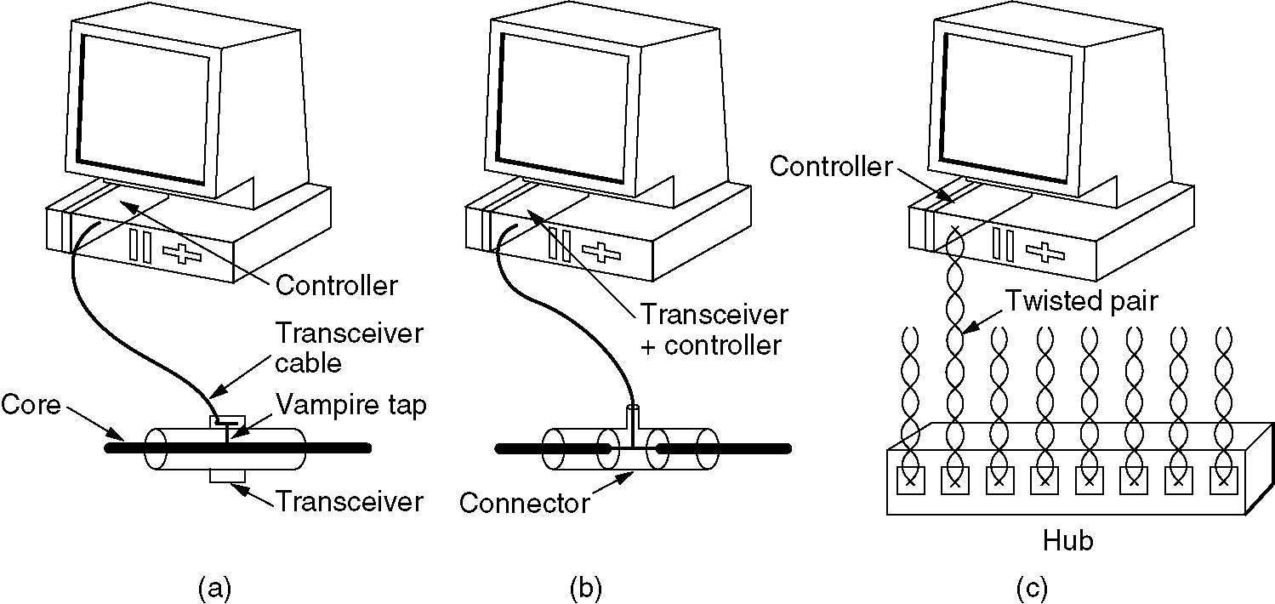
Ethernet Cabling (2)
Three kinds of Ethernet cabling.
(a) 10Base5, (b) 10Base2, (c) 10Base-T.

Slide 20
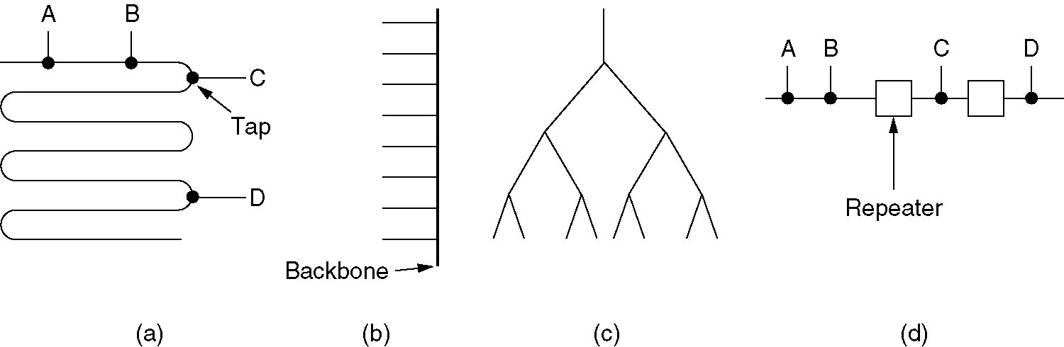
Ethernet Cabling (3)
Cable topologies. (a) Linear, (b) Spine, (c) Tree, (d) Segmented.

Slide 21
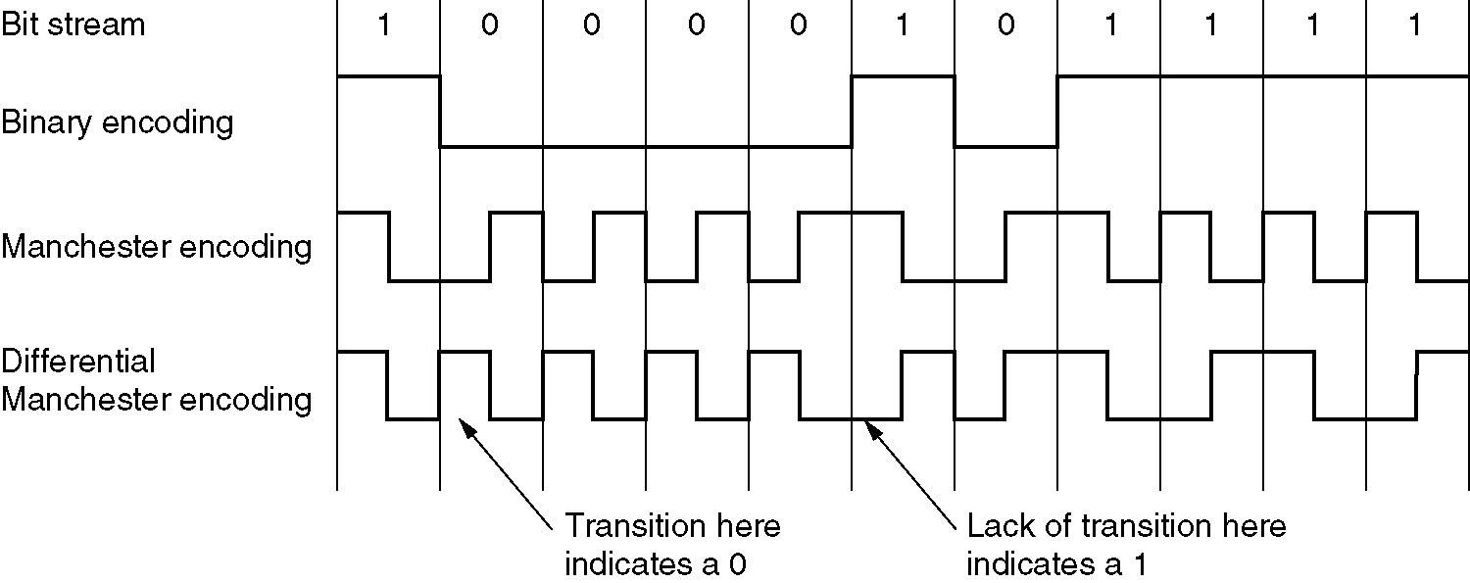
Ethernet Cabling (4)
(a) Binary encoding, (b) Manchester encoding, (c) Differential Manchester encoding.

Slide 22
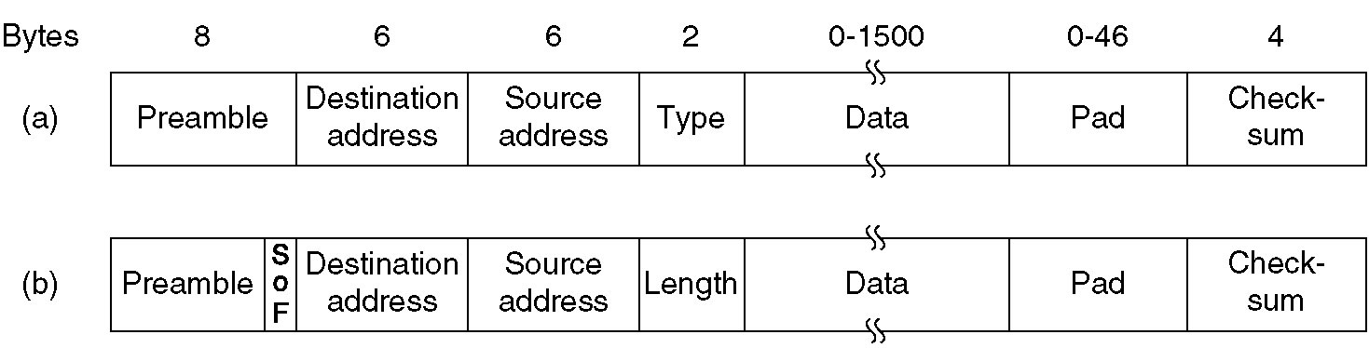
Ethernet MAC Sublayer Protocol
Frame formats. (a) DIX Ethernet, (b) IEEE 802.3.

Slide 23
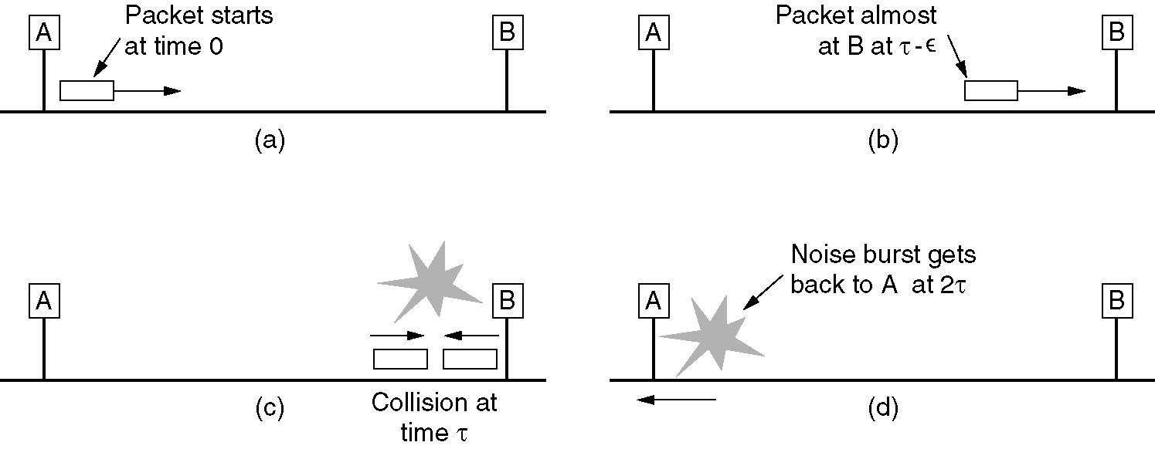
Ethernet MAC Sublayer Protocol (2)

Slide 24
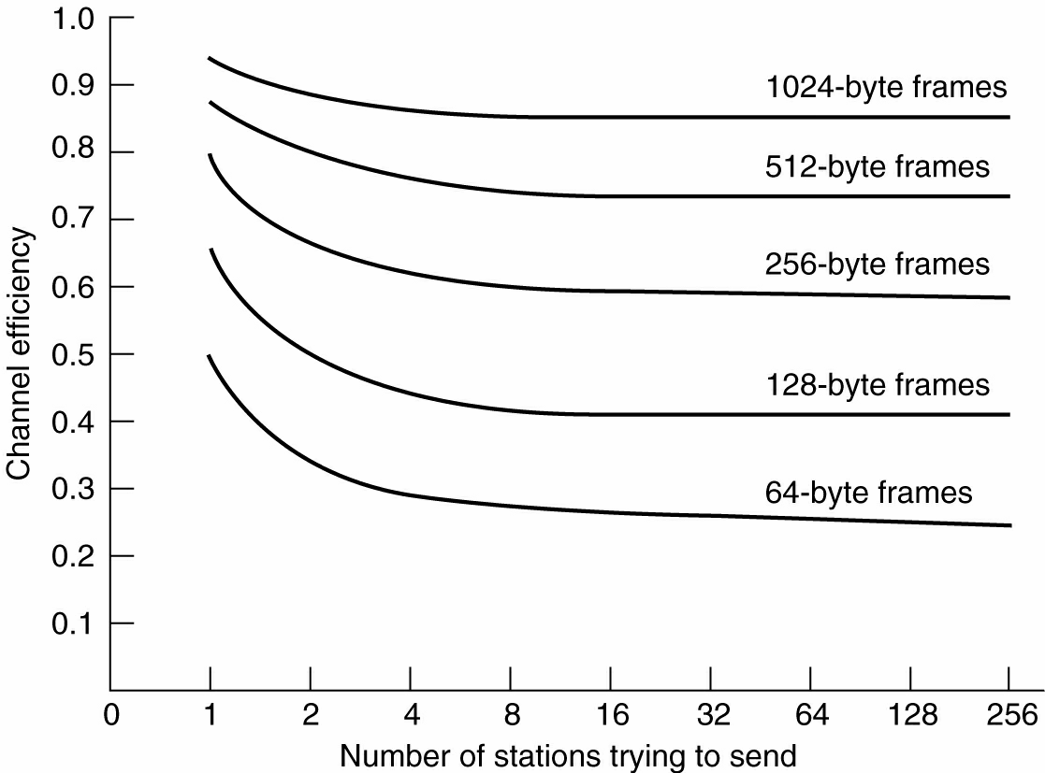
Ethernet Performance
Efficiency of Ethernet at 10 Mbps with 512-bit slot times.

Slide 25
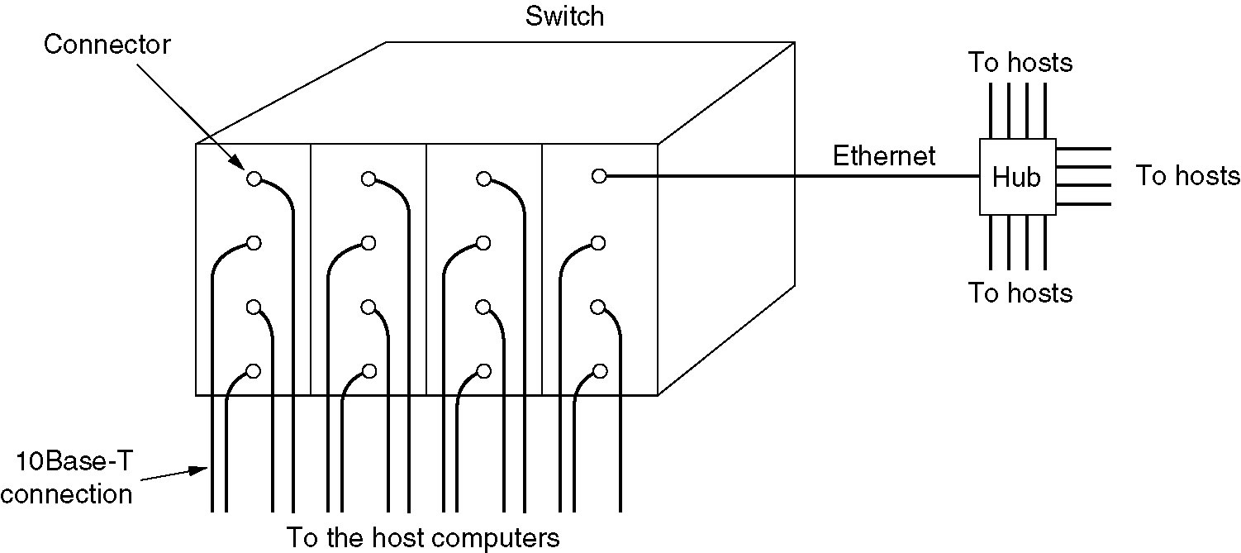
Switched Ethernet
A simple example of switched Ethernet.

Slide 26
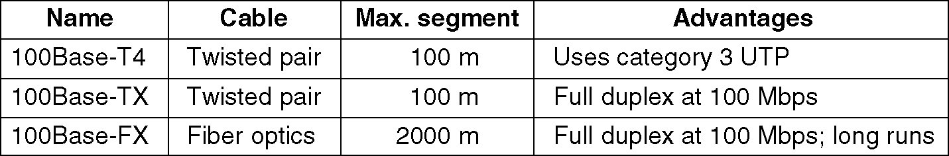
Fast Ethernet
The original fast Ethernet cabling.

Slide 27
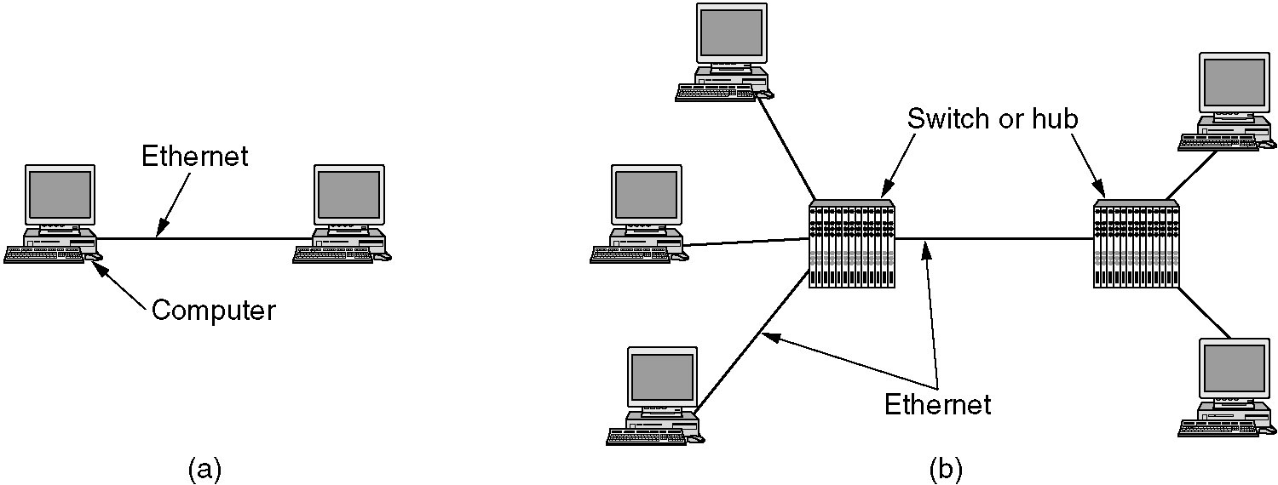
Gigabit Ethernet
(a) A two-station Ethernet. (b) A multistation Ethernet.

Slide 28
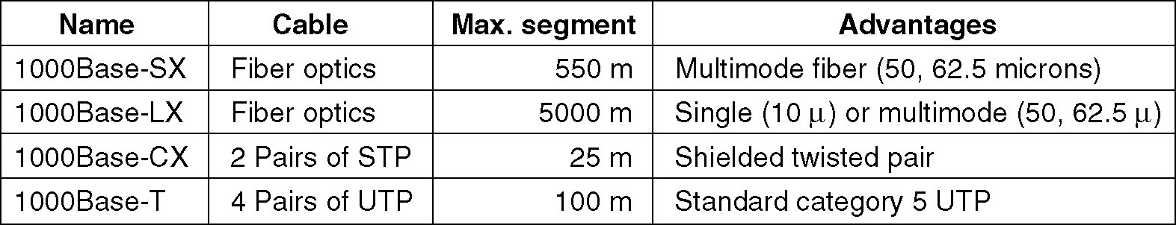
Gigabit Ethernet (2)
Gigabit Ethernet cabling.

Slide 29
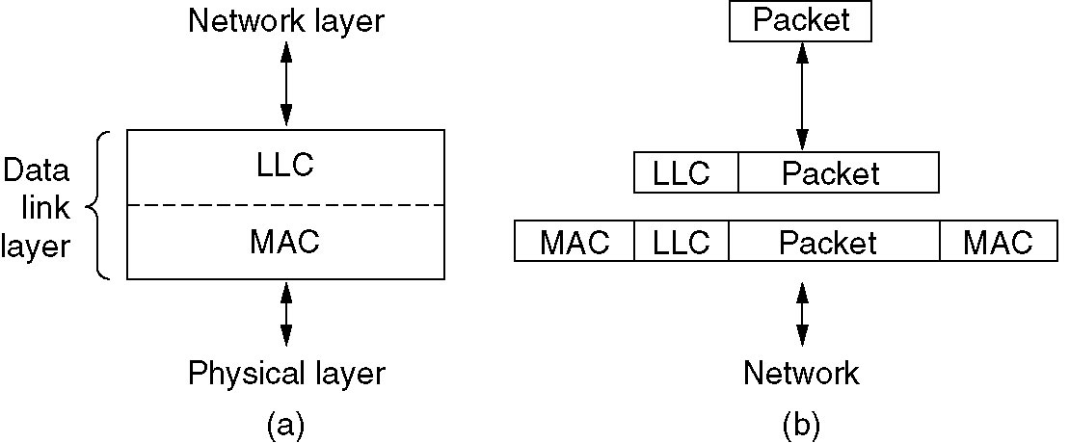
IEEE 802.2: Logical Link Control
(a) Position of LLC. (b) Protocol formats.

Slide 30
Wireless LANs
The 802.11 Protocol Stack
The 802.11 Physical Layer
The 802.11 MAC Sublayer Protocol
The 802.11 Frame Structure
Services

Slide 31
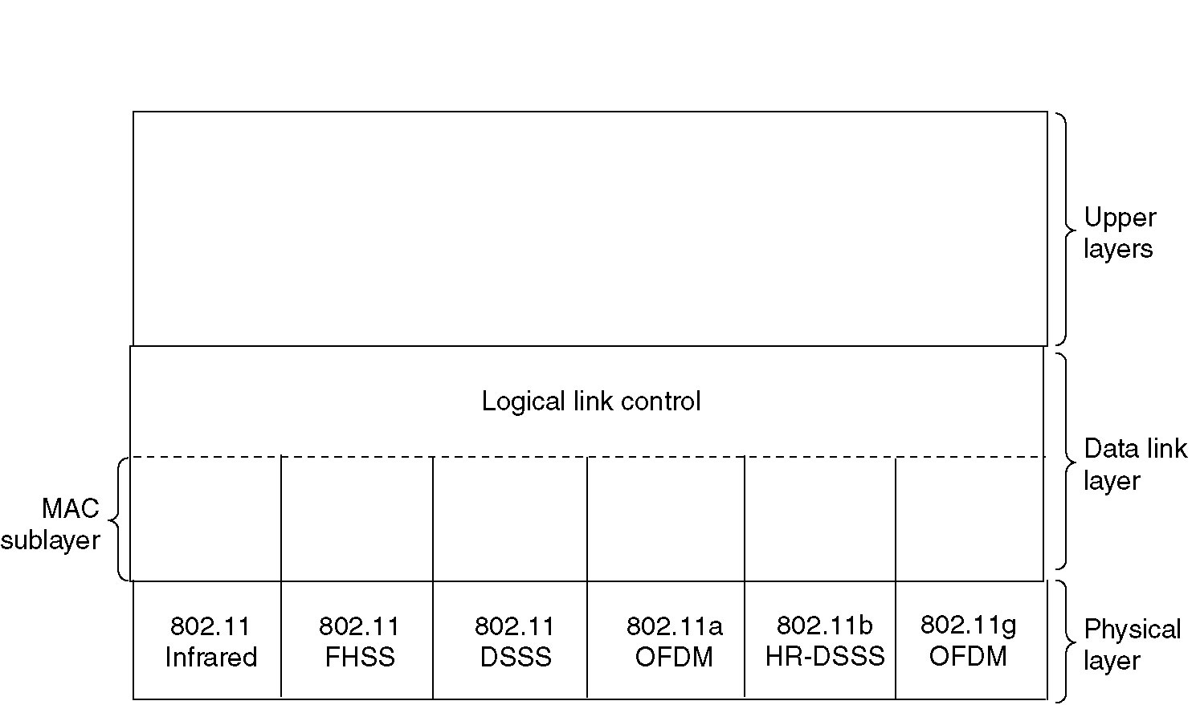
The 802.11 Protocol Stack
Part of the 802.11 protocol stack.

Slide 32
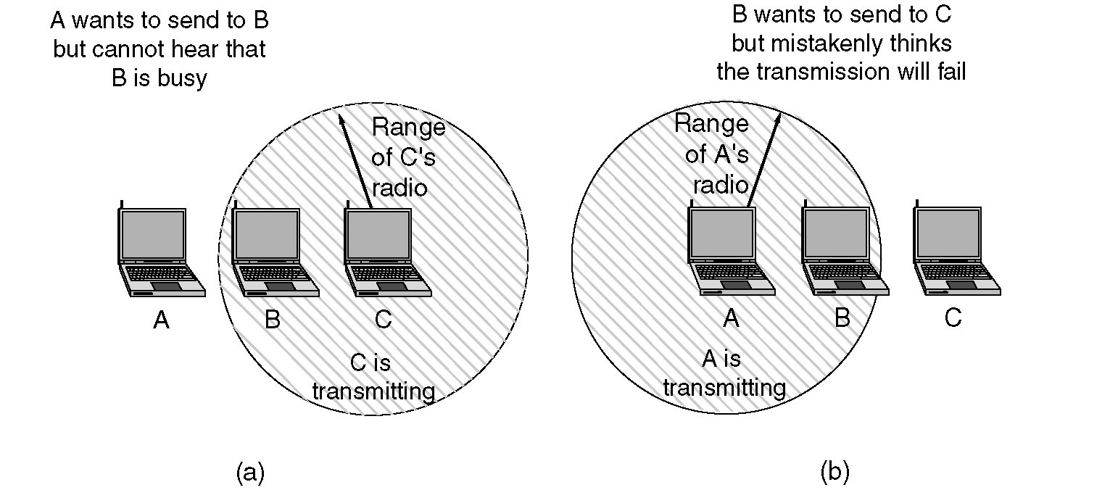
The 802.11 MAC Sublayer Protocol
(a) The hidden station problem.
(b) The exposed station problem.

Slide 33
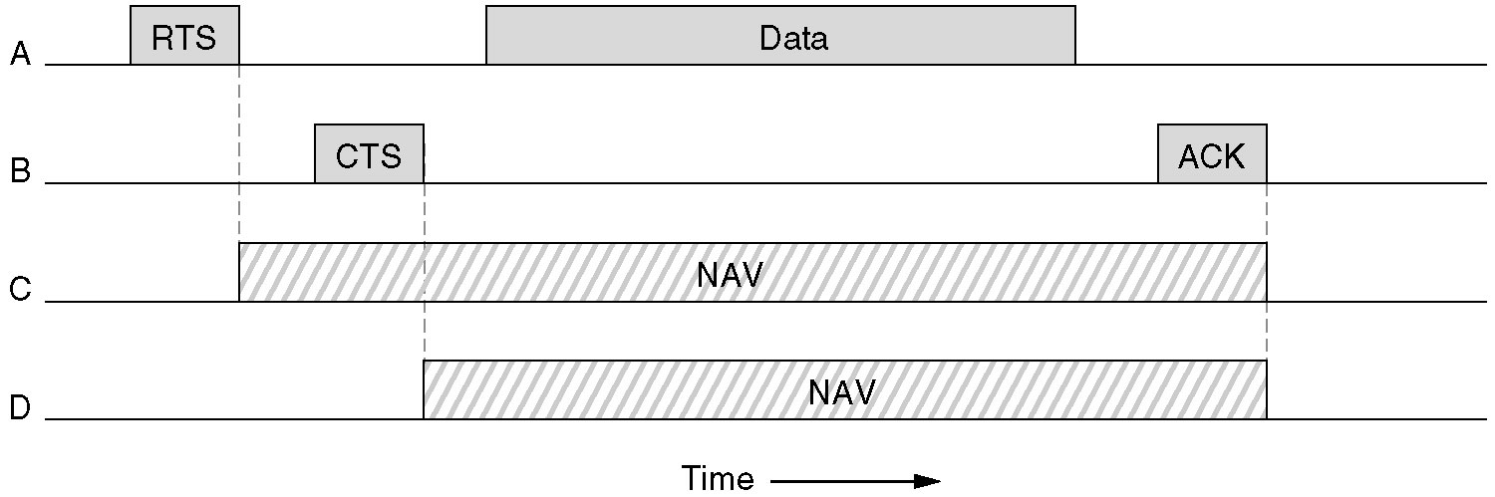
The 802.11 MAC Sublayer Protocol (2)
The use of virtual channel sensing using CSMA/CA.

Slide 34
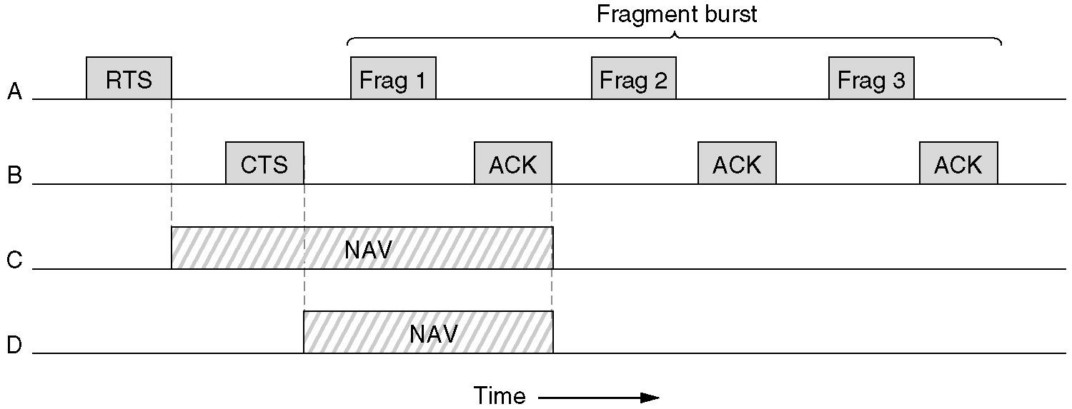
The 802.11 MAC Sublayer Protocol (3)
A fragment burst.

Slide 35
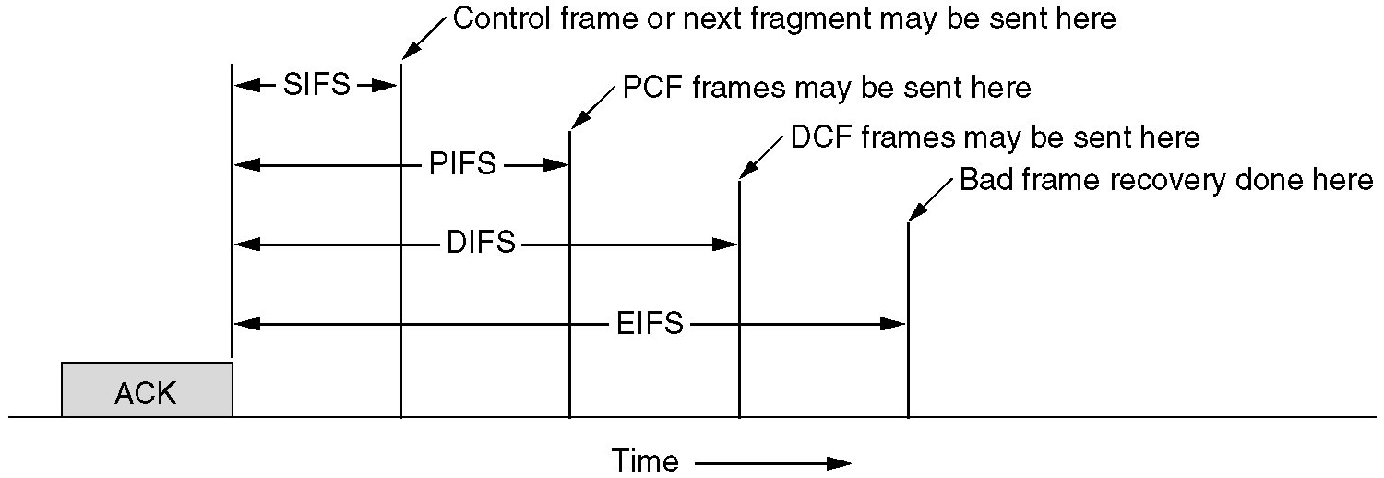
The 802.11 MAC Sublayer Protocol (4)
Interframe spacing in 802.11.

Slide 36
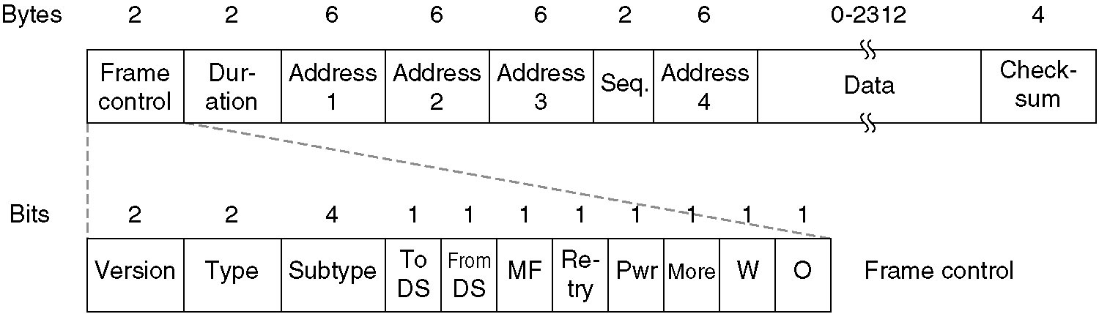
The 802.11 Frame Structure
The 802.11 data frame.

Slide 37
802.11 Services
Distribution Services
Association
Disassociation
Reassociation
Distribution
Integration

Slide 38
802.11 Services
Intracell Services
Authentication
Deauthentication
Privacy
Data Delivery

Slide 39
Broadband Wireless
Comparison of 802.11 and 802.16
The 802.16 Protocol Stack
The 802.16 Physical Layer
The 802.16 MAC Sublayer Protocol
The 802.16 Frame Structure

Slide 40
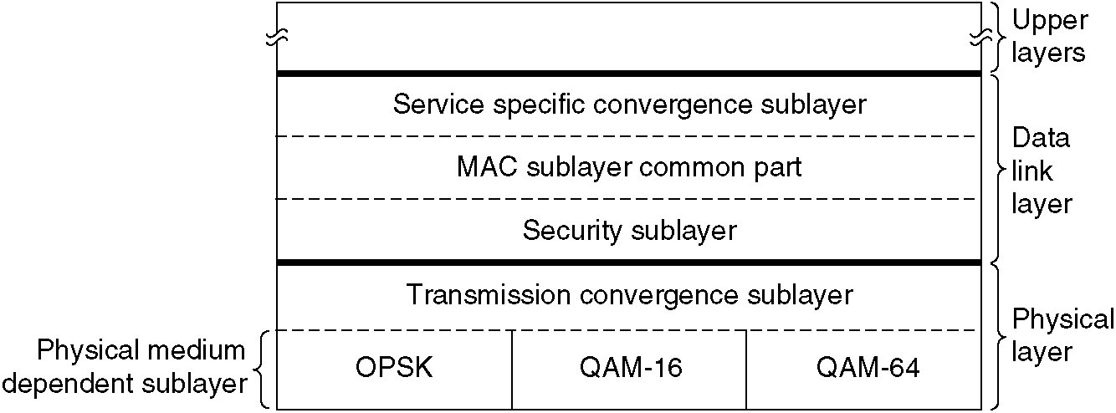
The 802.16 Protocol Stack
The 802.16 Protocol Stack.

Slide 41
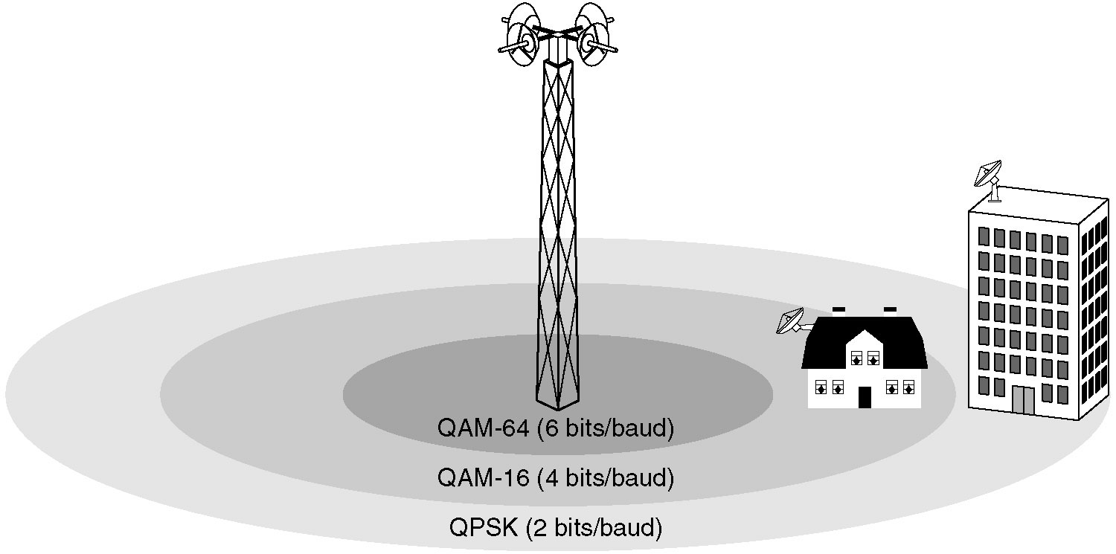
The 802.16 Physical Layer
The 802.16 transmission environment.

Slide 42
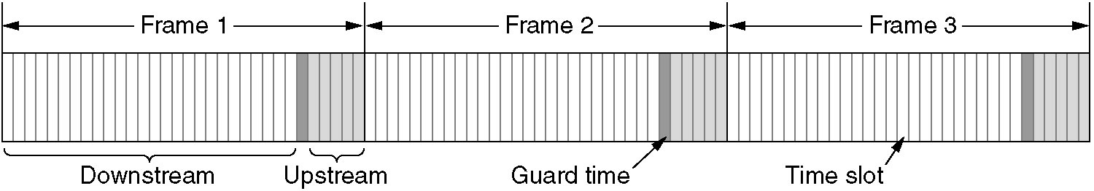
The 802.16 Physical Layer (2)
Frames and time slots for time division duplexing.

Slide 43
The 802.16 MAC Sublayer Protocol
Service Classes
Constant bit rate service
Real-time variable bit rate service
Non-real-time variable bit rate service
Best efforts service

Slide 44
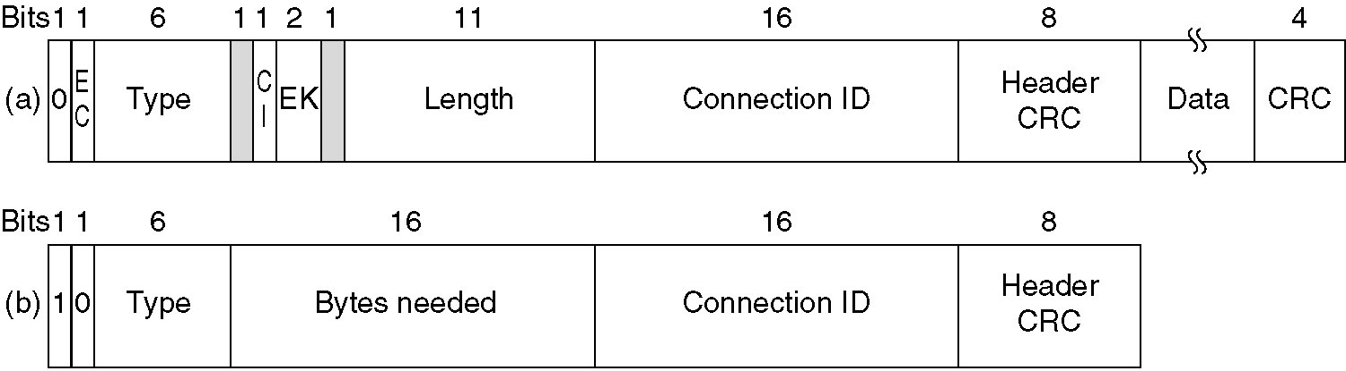
The 802.16 Frame Structure
(a) A generic frame. (b) A bandwidth request frame.

Slide 45
Bluetooth
Bluetooth Architecture
Bluetooth Applications
The Bluetooth Protocol Stack
The Bluetooth Radio Layer
The Bluetooth Baseband Layer
The Bluetooth L2CAP Layer
The Bluetooth Frame Structure

Slide 46
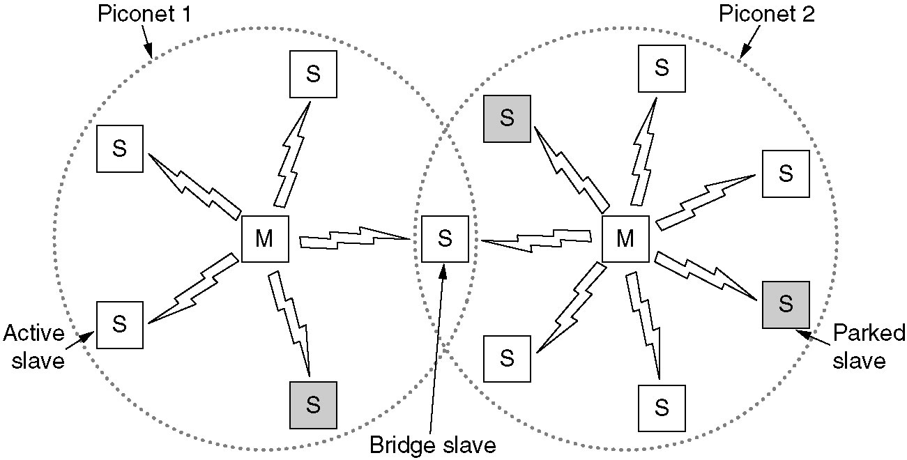
Bluetooth Architecture
Two piconets can be connected to form a scatternet.

Slide 47
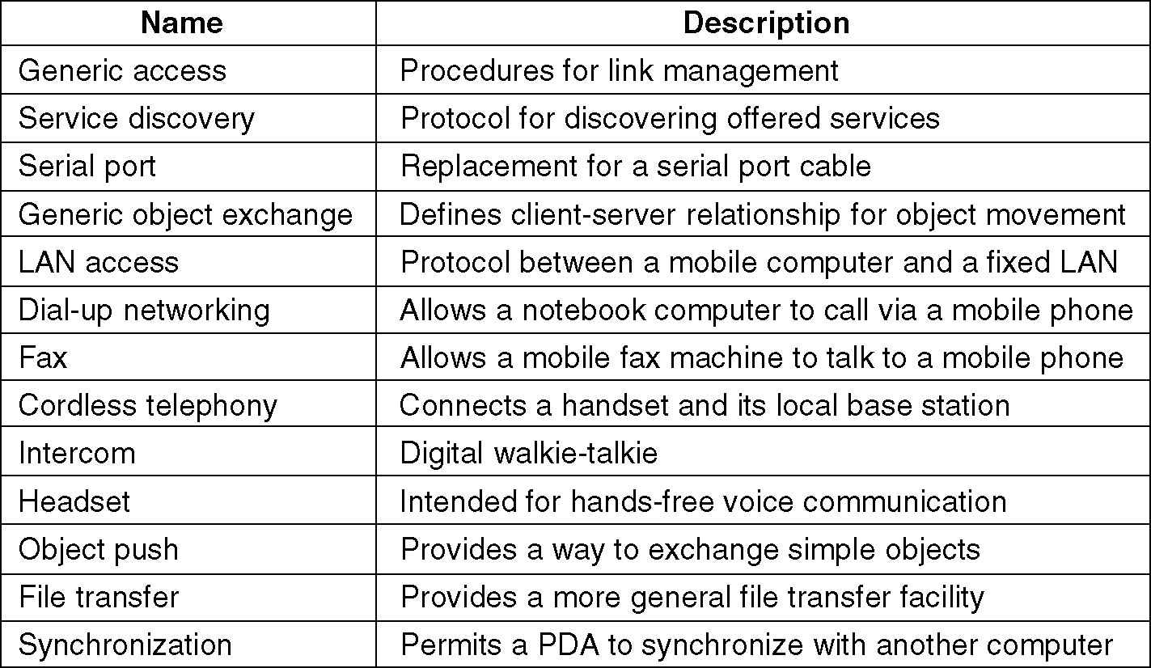
Bluetooth Applications
The Bluetooth profiles.

Slide 48
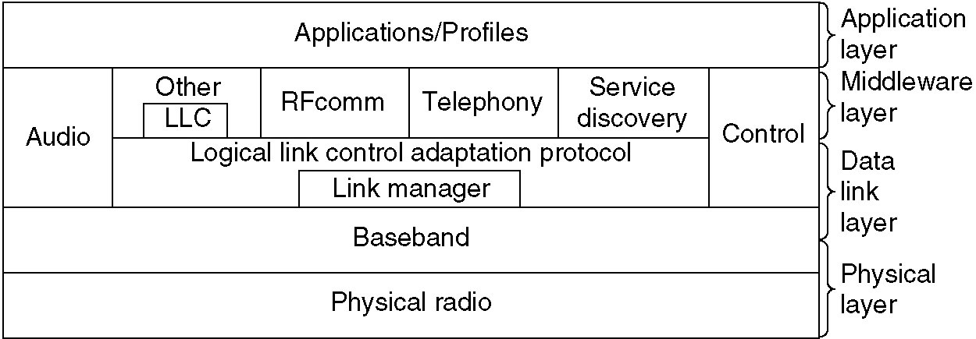
The Bluetooth Protocol Stack
The 802.15 version of the Bluetooth protocol architecture.

Slide 49
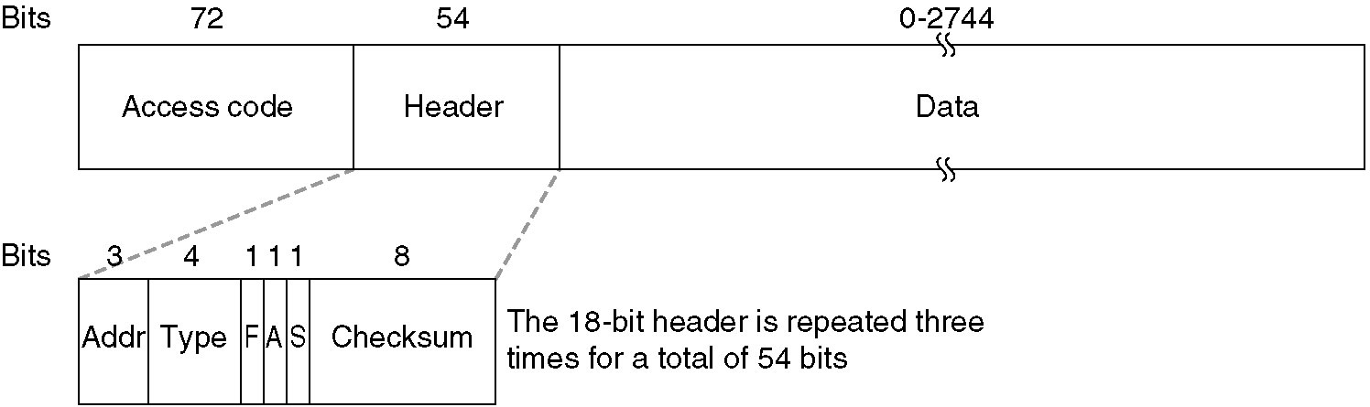
The Bluetooth Frame Structure
A typical Bluetooth data frame.

Slide 50
Data Link Layer Switching
Bridges from 802.x to 802.y
Local Internetworking
Spanning Tree Bridges
Remote Bridges
Repeaters, Hubs, Bridges, Switches, Routers, Gateways
Virtual LANs

Slide 51
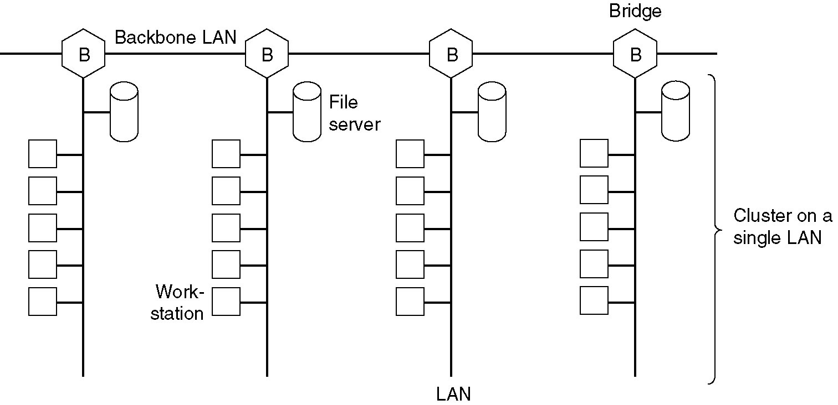
Data Link Layer Switching
Multiple LANs connected by a backbone to handle a total load higher than the capacity of a single LAN.

Slide 52
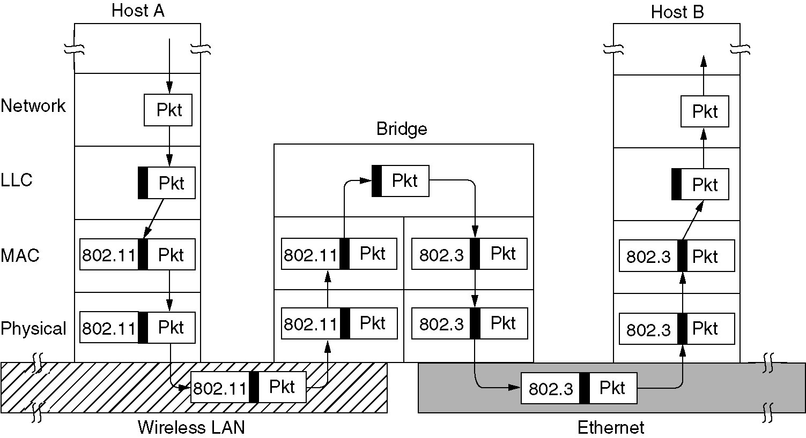
Bridges from 802.x to 802.y
Operation of a LAN bridge from 802.11 to 802.3.

Slide 53
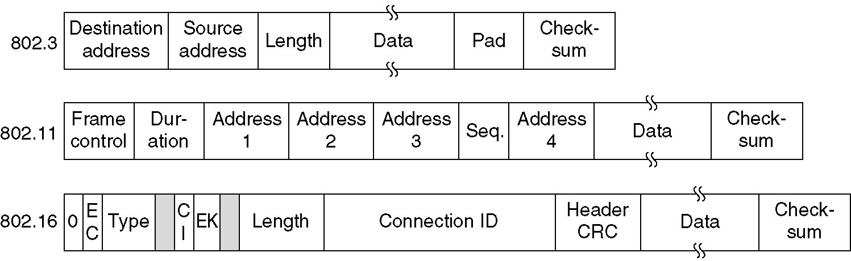
Bridges from 802.x to 802.y (2)
The IEEE 802 frame formats. The drawing is not to scale.

Slide 54
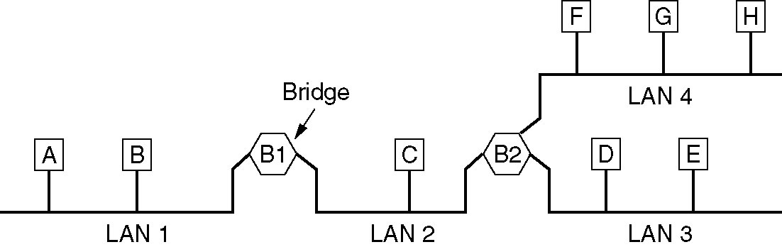
Local Internetworking
A configuration with four LANs and two bridges.

Slide 55
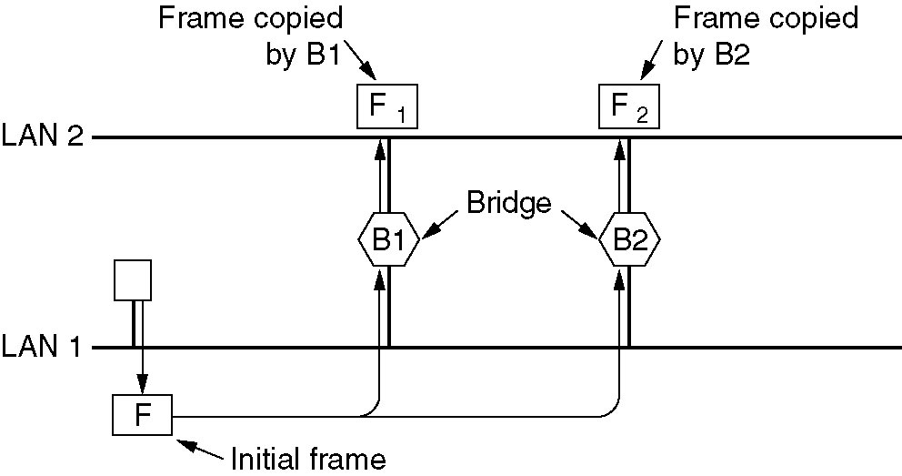
Spanning Tree Bridges
Two parallel transparent bridges.

Slide 56
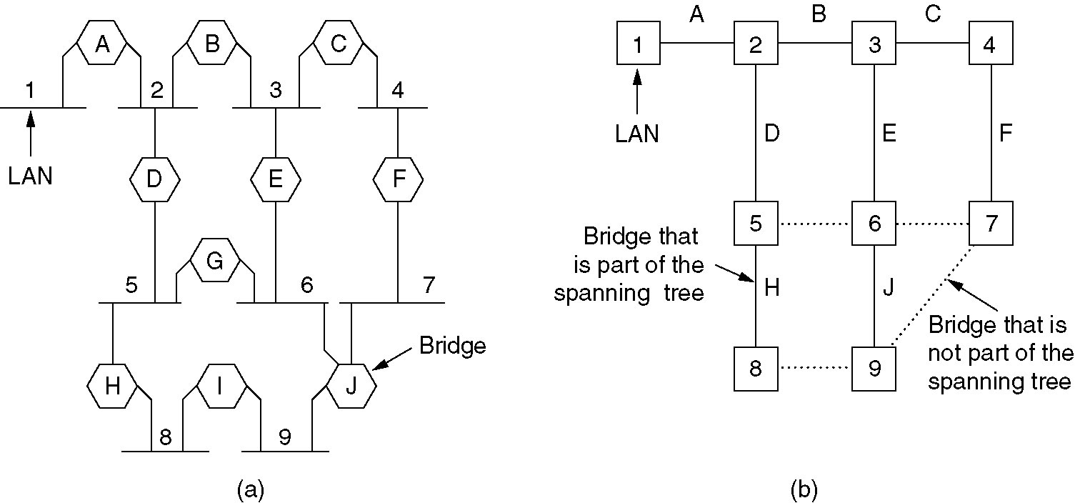
Spanning Tree Bridges (2)
(a) Interconnected LANs. (b) A spanning tree covering the LANs. The dotted lines are not part of the spanning tree.

Slide 57
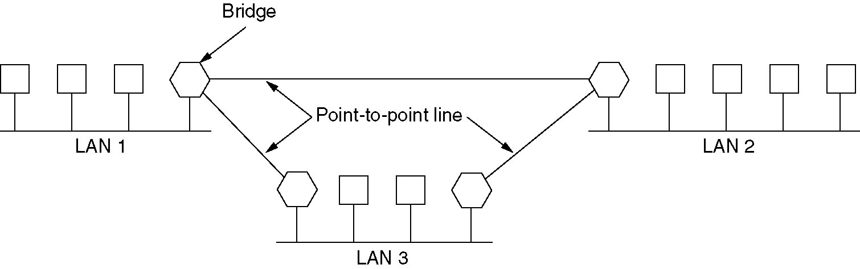
Remote Bridges
Remote bridges can be used to interconnect distant LANs.

Slide 58
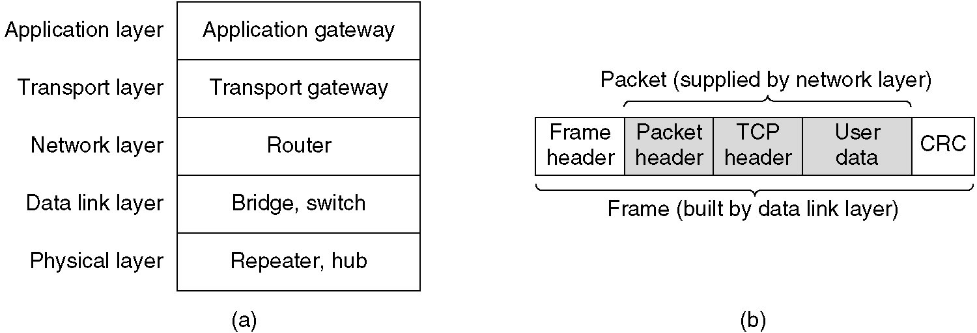
Repeaters, Hubs, Bridges, Switches, Routers and Gateways
(a) Which device is in which layer.
(b) Frames, packets, and headers.

Slide 59
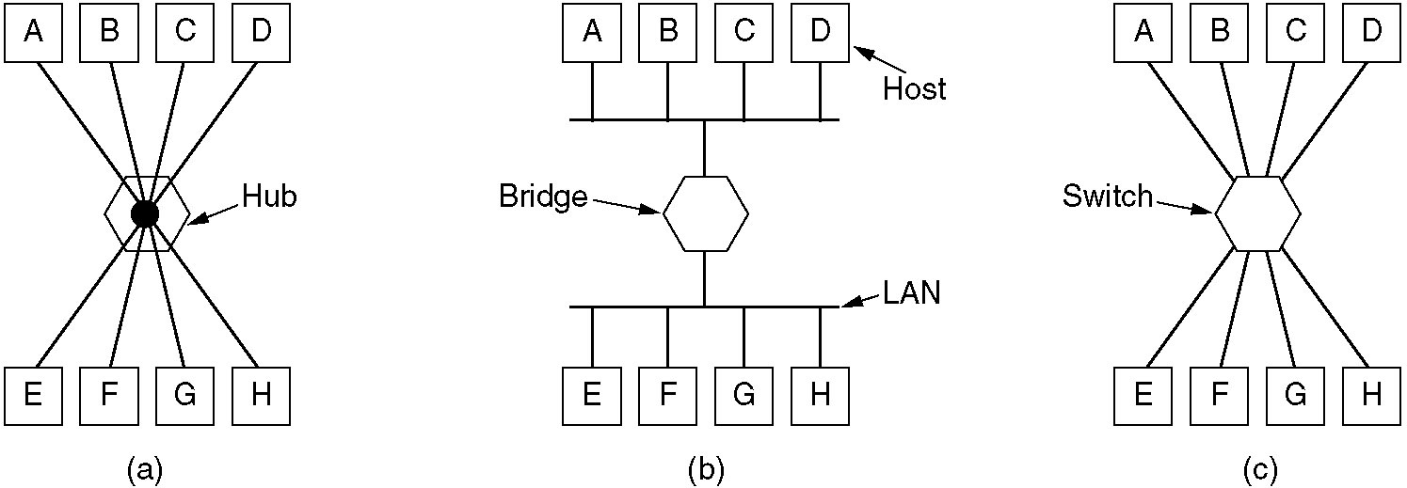
Repeaters, Hubs, Bridges, Switches, Routers and Gateways (2)
(a) A hub. (b) A bridge. (c) a switch.

Slide 60
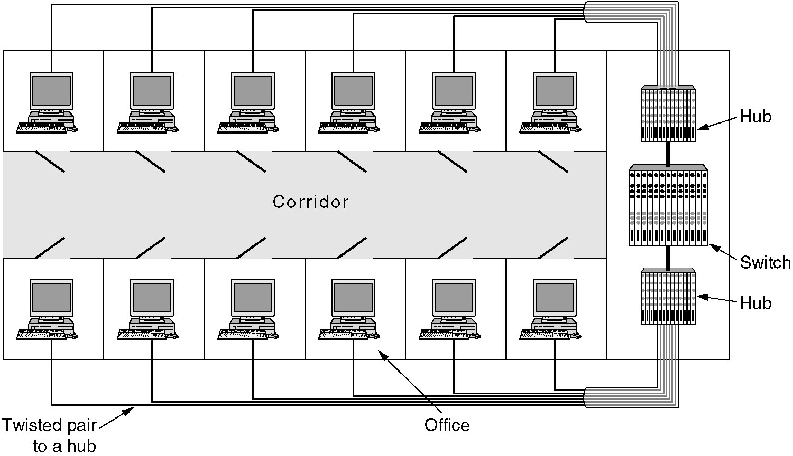
Virtual LANs
A building with centralized wiring using hubs and a switch.

Slide 61
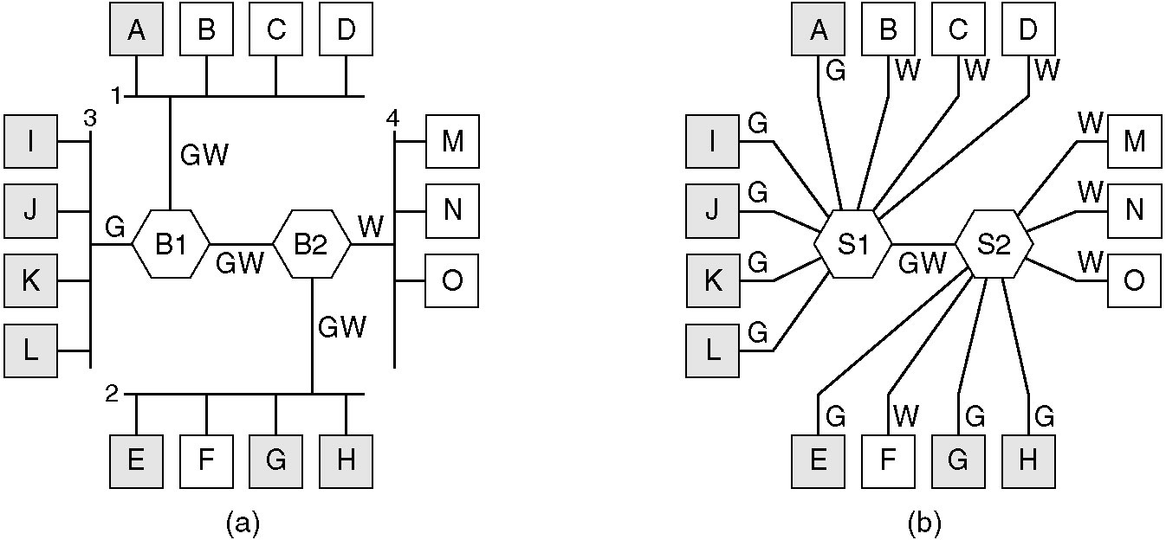
Virtual LANs (2)
(a) Four physical LANs organized into two VLANs, gray and white, by two bridges. (b) The same 15 machines organized into two VLANs by switches.

Slide 62
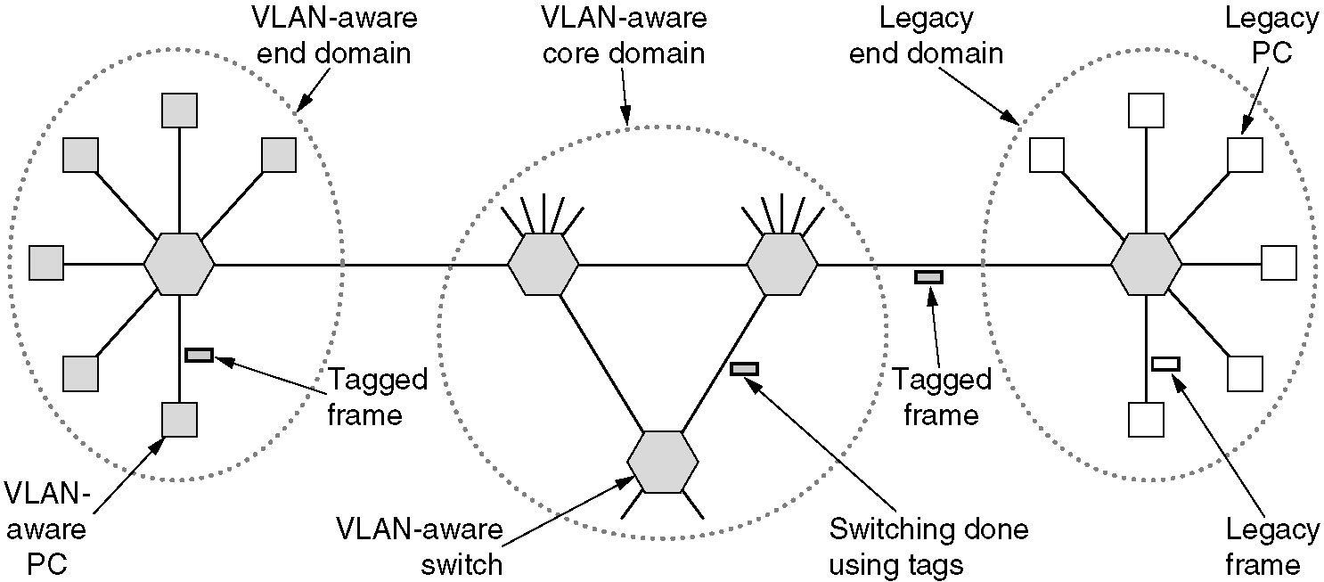
The IEEE 802.1Q Standard
Transition from legacy Ethernet to VLAN-aware Ethernet. The shaded symbols are VLAN aware. The empty ones are not.

Slide 63

The IEEE 802.1Q Standard (2)
The 802.3 (legacy) and 802.1Q Ethernet frame formats.

Slide 64

Summary
Channel allocation methods and systems for a common channel.

